Slide 1
1
Attendance Taking
System
Done by: Yong Teng & Wei Jie

Slide 2



Introduction
This project is about making school campus efficiency and time saving by taking attendance using paper and pen.
Pen and Paper
Manual Headcount
Repetitive

Slide 3



Scope
Reduce time taken
Efficiency
Preventing any falsification during attendance taking
User friendly
Easy to use

Slide 4
2
Relation To Smart
Nation

Slide 5
Relation To Smart Nation
By harnessing technology to improve the life of others.
Uses data and technologies to increase efficiencies
Streamlining staff’s responsibilities
Information are readily accessible

Slide 6
4
Resources Required
And Technologies
Used

Slide 7





Resources Required
RFID Sensor
Camera
Computer

Slide 8


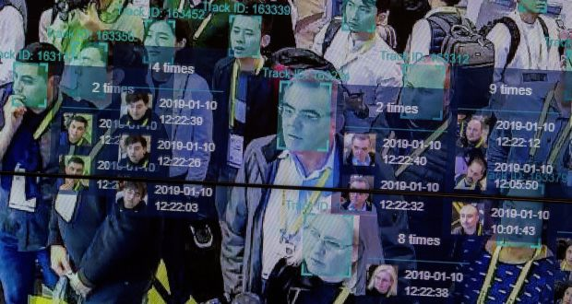
Technologies Used

Slide 9
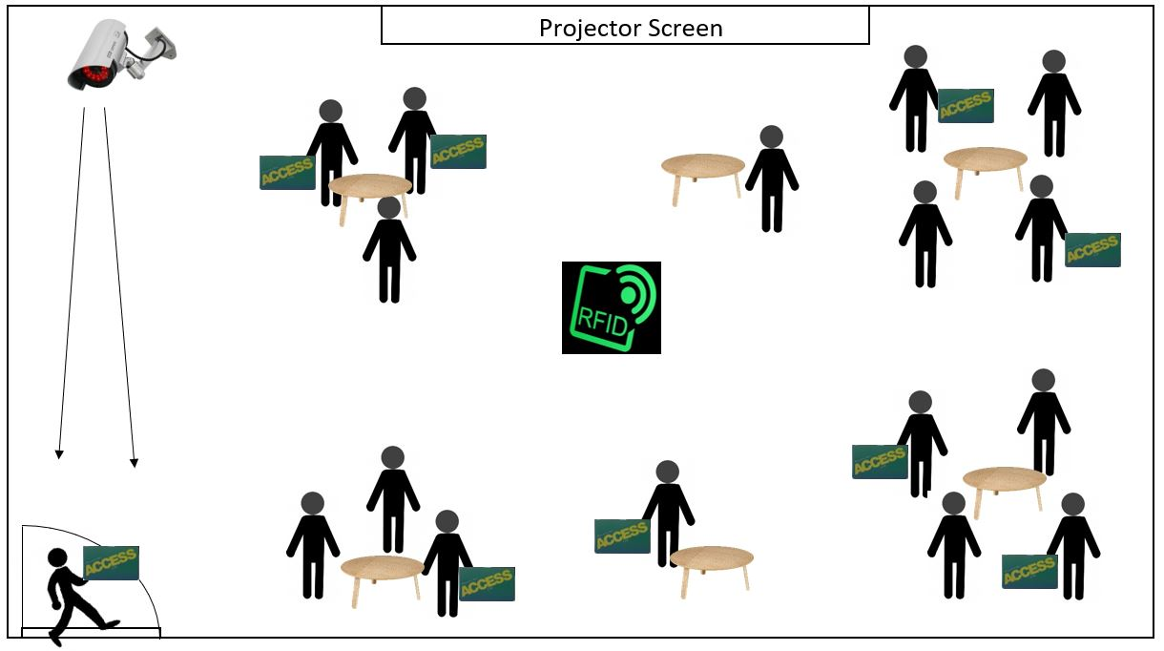
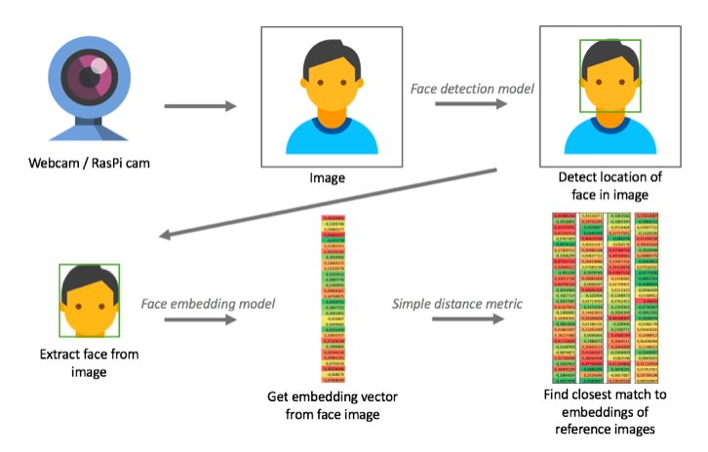
Purpose:
Save Time and Effort, Improve Efficiency.
Prevents Falsification
User Friendly
Easy to Use
Yellow System
Student Card ID Student’s Image

Slide 10
<It’s Time To Look Into Our Project>

Slide 11
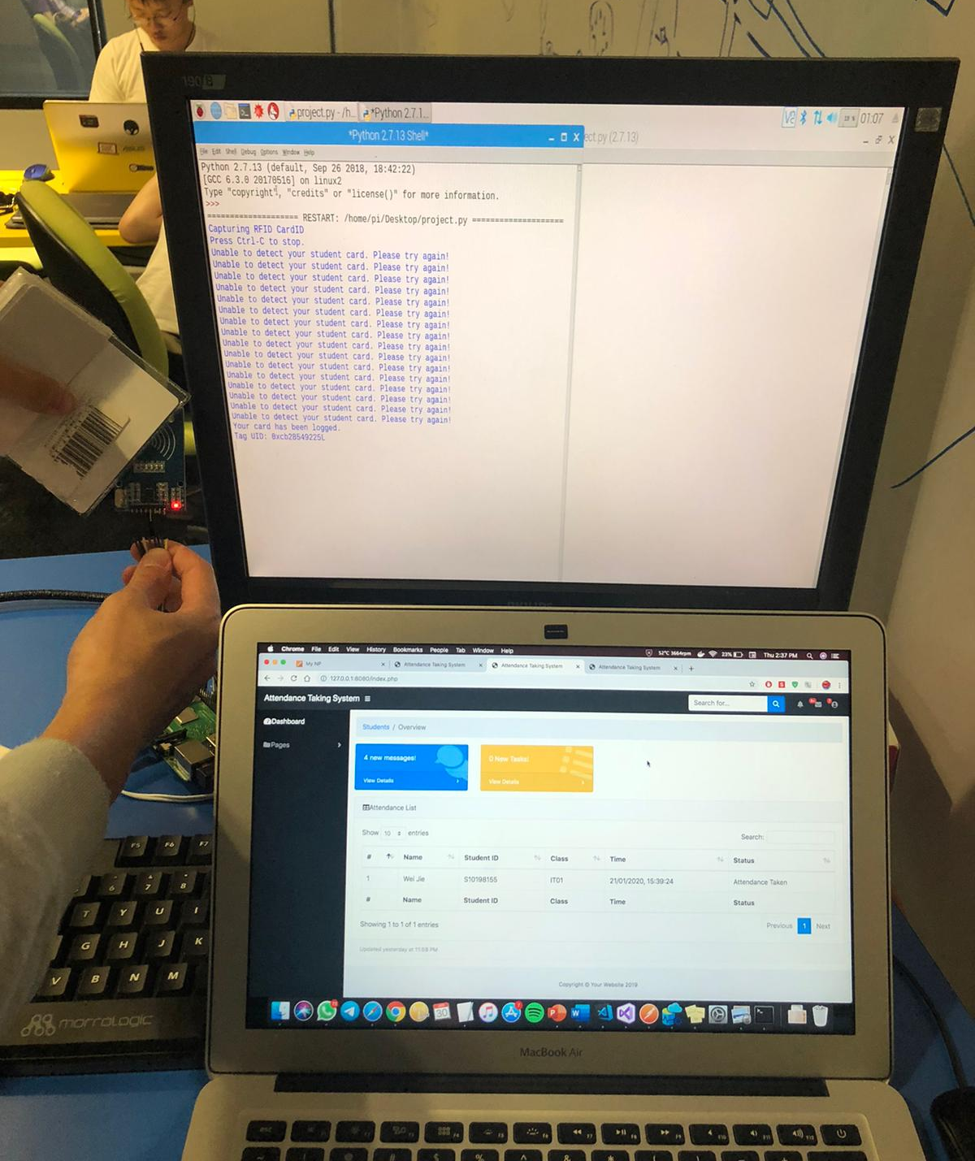
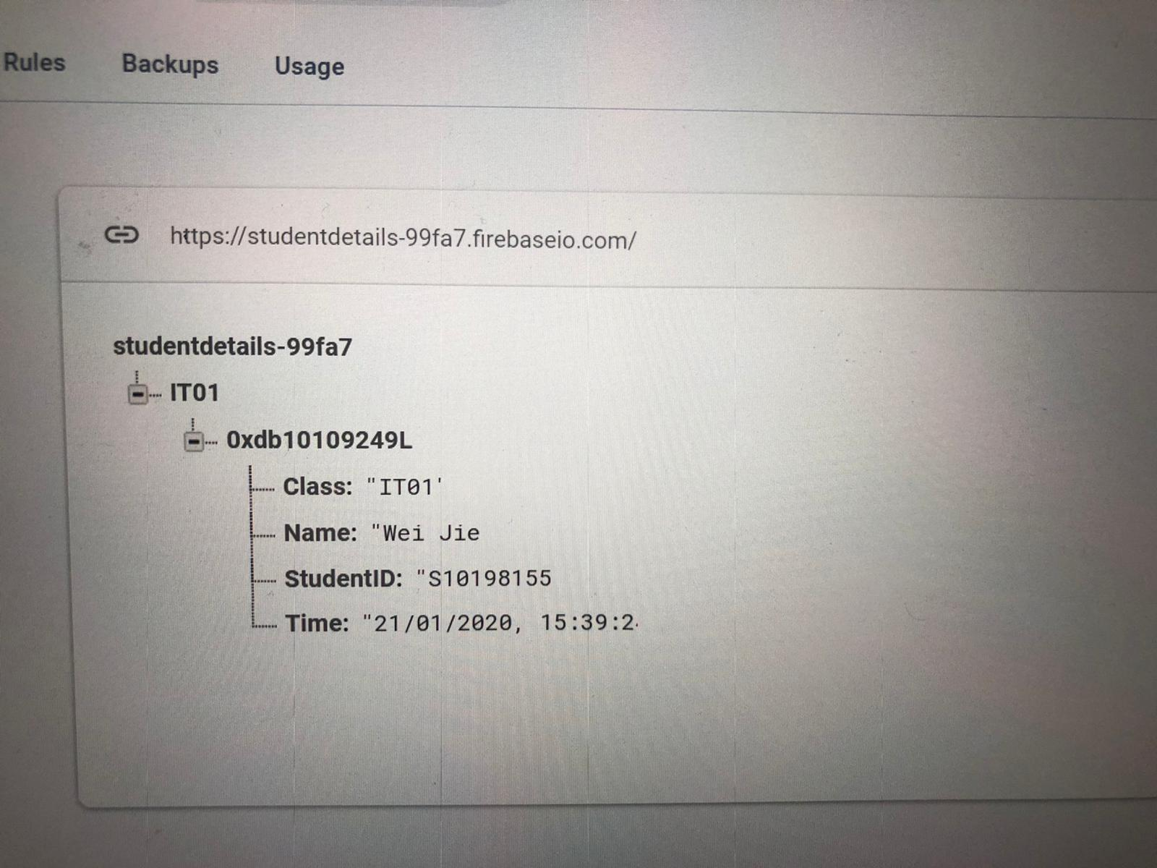
Step 1
RFID Sensor detects card within a distance
Push an entry record into firebase
Notes:
Student tap their student card on the NFC device ----> RFID Sensor detects card within a distance

Slide 12
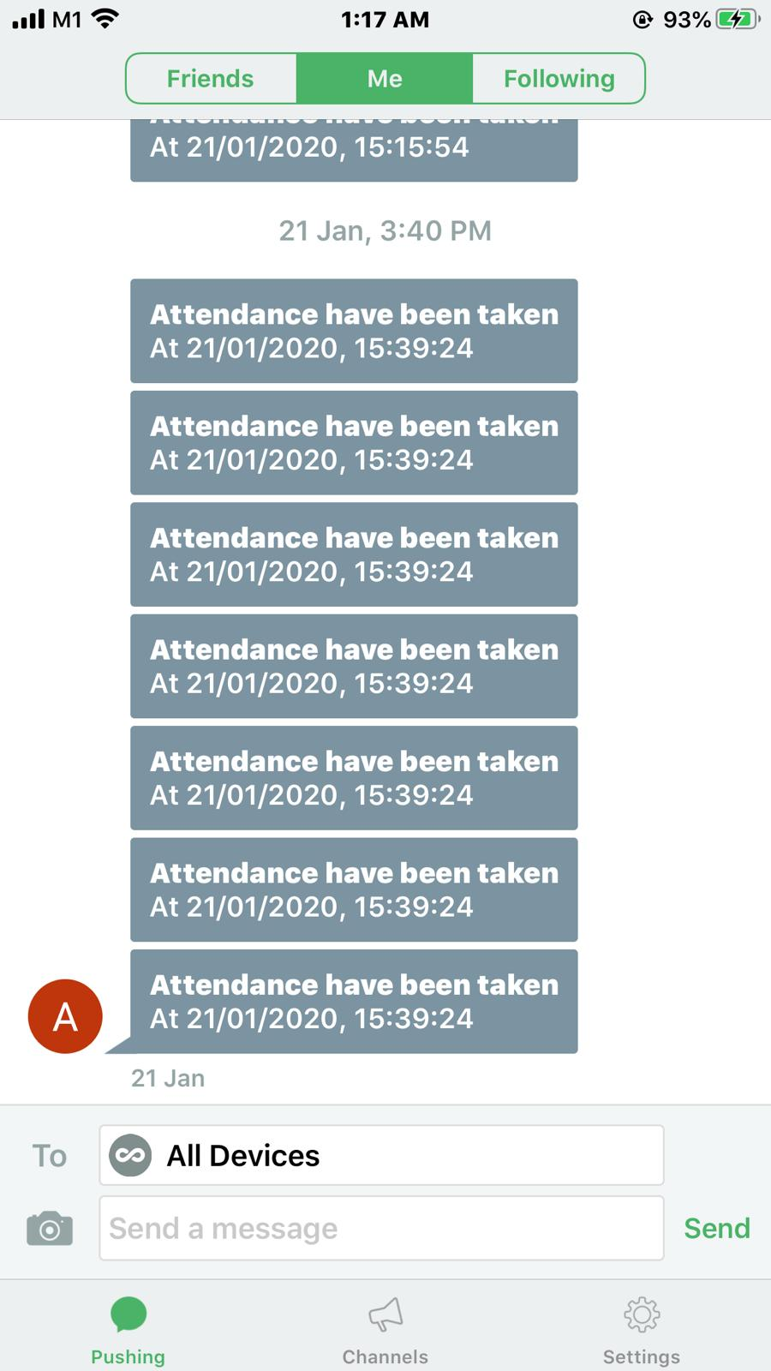
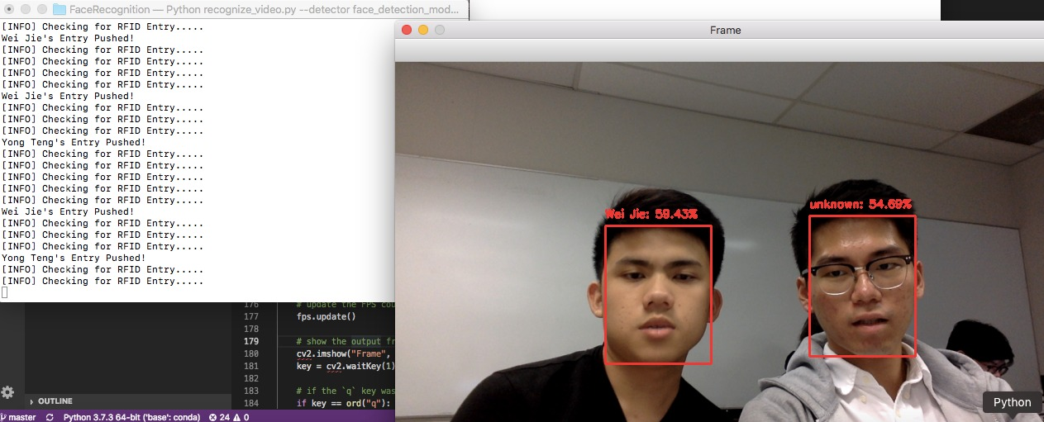
Step 2
Facial Recognition Program checks the user face for a match
Send a notification through pushbullet app to user

Slide 13
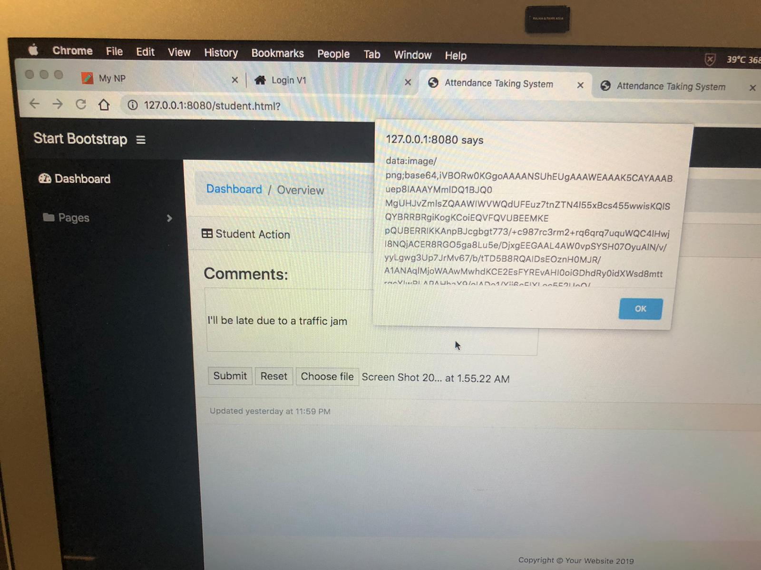
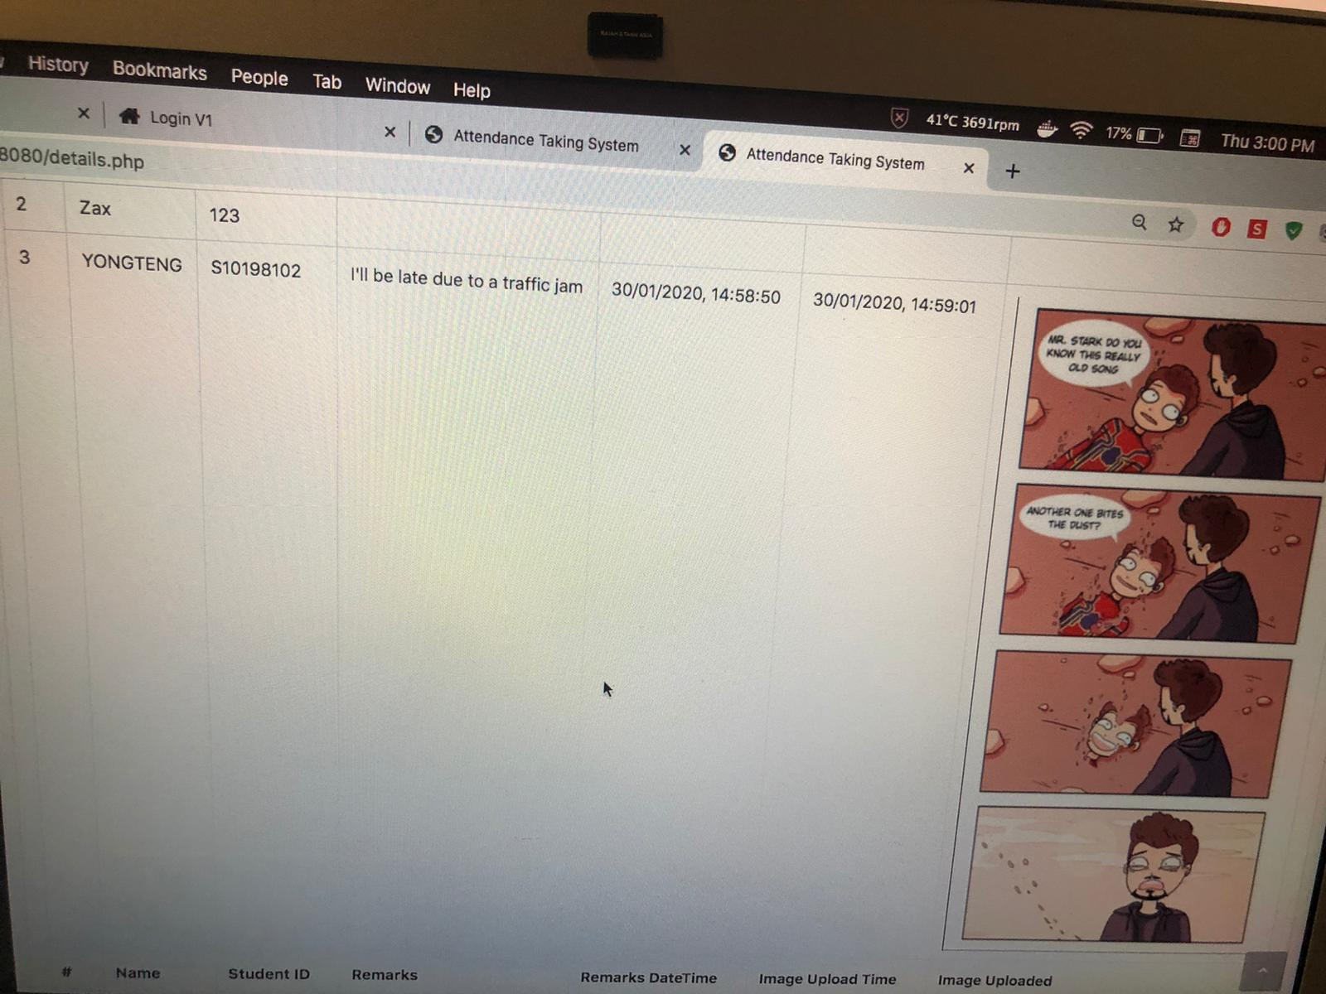
Step 3
Send a message to lecturer through web page
Upload document to lecturer through web page

Slide 14
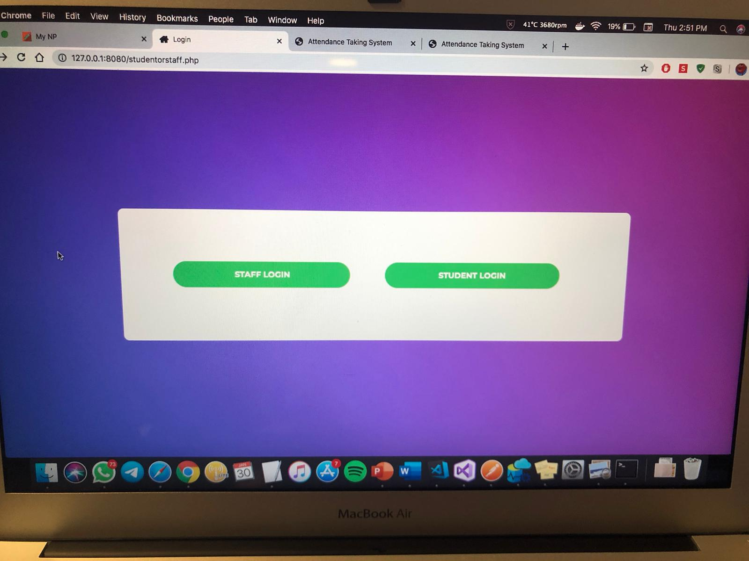
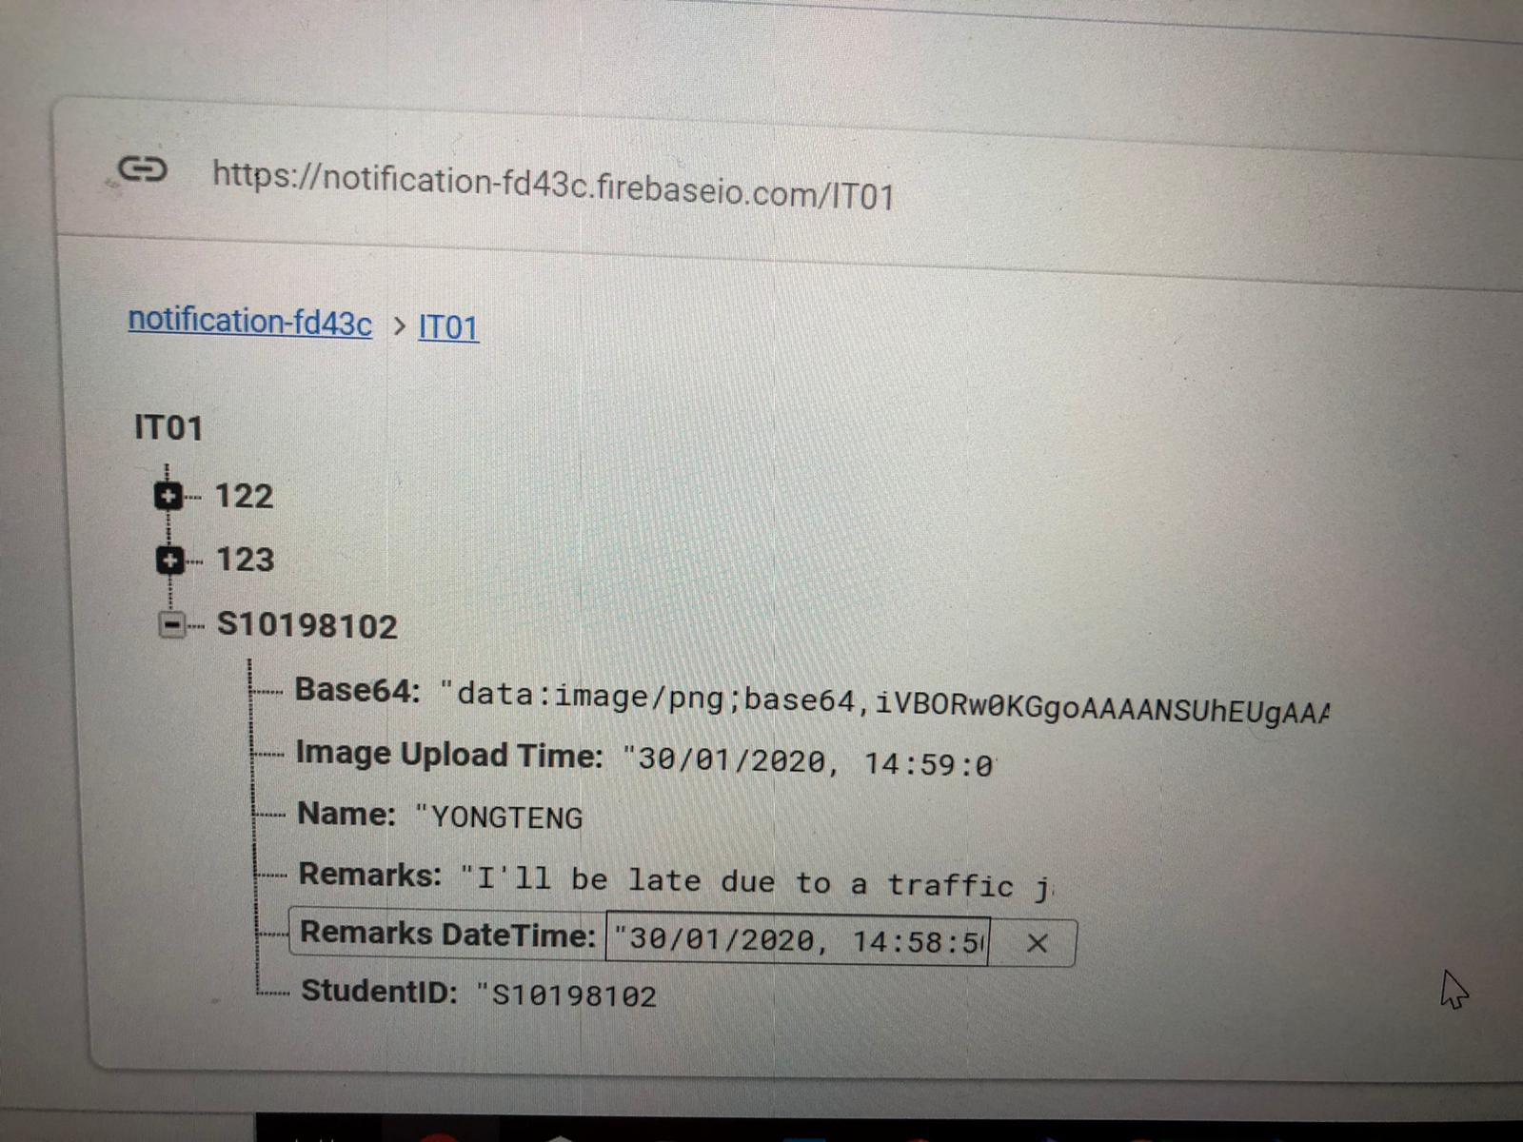
Step 4
Lecturer can login to web page to check student attendance
A record will be taken through firebase

Slide 15
It’s DeMo Time!!

Slide 16

Thank You!

